Slide 1
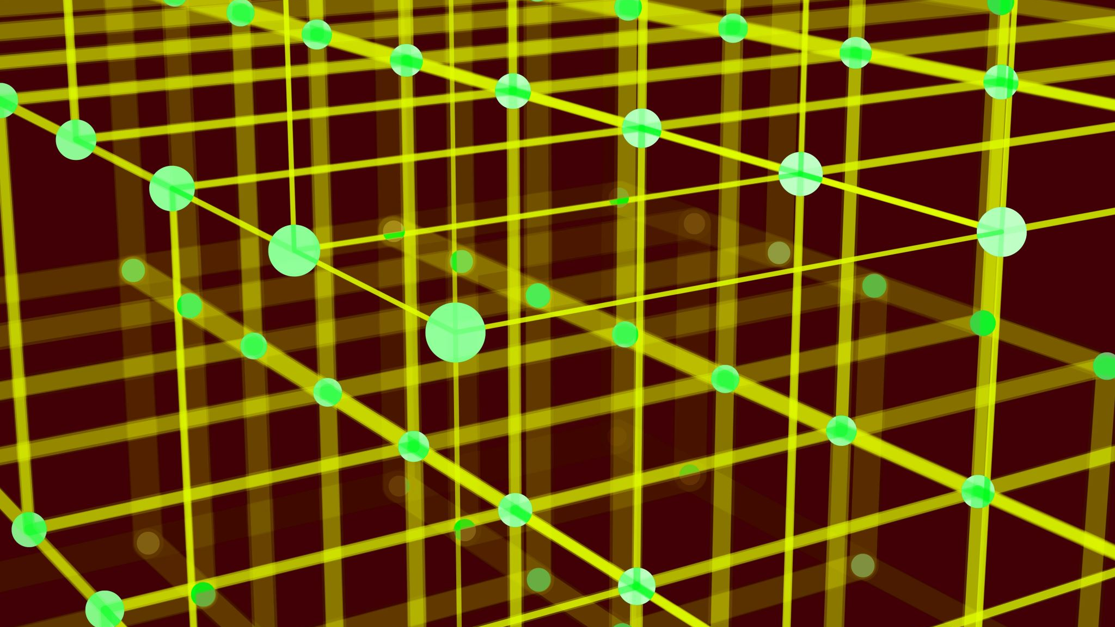
Two dimensional arrays

Slide 2

Two-dimensional arrays
A two-dimensional array is a doubly-indexed sequence of values of the same type.
Examples
Matrices in math calculations.
Grades for students in an online class.
Outcomes of scientific experiments.
Transactions for bank customers.
Pixels in a digital image.
Geographic data
...
course id
 | 0 | 1 | 2 | 3 | 4 | 5 | 6 | …
0 | B | A | B | C | A | D | A
1 | A | B | B | C | A | C | C
2 | C | C | A | A | C | B | B
3 | C | A | B | B | A | A | C
4 | A | D | A | C | C | B | A
5 | B | C | D | A | B | C | A
6 | A | B | A | B | B | A | C
…
student id
y-coordinate
x-coordinate
Main purpose. Facilitate storage and manipulation of data.

Slide 3
C++ language support for two-dimensional arrays
Basic Support
operation | typical code
Declare an array | int a[1000][1000];
Declare and initialize an array | int a[2][3] = { {10, 20, 30}, {15, 25, 35} };
Refer to an array entry by index | a[i][j] = b[i][k] + c[k][j];
Refer to number of rows | std::size(a)
Refer to row i | a[i]
Refer to number of columns | std::size(a[i])
no way to refer to column j
a
a[0][0] | a[0][1] | a[0][2] | a[0][3] | a[0][4] | a[0][5] | a[0][6] | a[0][7] | a[0][8] | a[0][9]
a[1][0] | a[1][1] | a[1][2] | a[1][3] | a[1][4] | a[1][5] | a[1][6] | a[1][7] | a[1][8] | a[1][9]
a[2][0] | a[2][1] | a[2][2] | a[2][3] | a[2][4] | a[2][5] | a[2][6] | a[2][7] | a[2][8] | a[2][9]
a[1]
a 3-by-10 array

Slide 4
Two-dimensional arrays: Initialization options
operation | typical code
Only declaration, no initialization | int a[1000][1000];
Initialize to default value (0 for numeric data types) | int a[1000][1000] {};
Declare and initialize an array | int a[2][3] = { {10, 20, 30}, {15, 25, 35} };
Left –most dimension can be omitted when given initialization list | int a[][3] = { {10, 20, 30}, {15, 25, 35} };
Remaining entries initialized to default value | int a[2][3] = { {10, 20, 30} }
Remaining entries initialized to default value | int a[][3] = { {10, 20}, {}, {15} };
Can be initialized using 1-d initialization list (row-major order) Remaining entries initialized to default value | int a[2][3] = {10, 20, 30, 15};

Slide 5
Application of arrays: vector and matrix calculations
Mathematical abstraction: vector
C++ implementation: 1D array
Mathematical abstraction: matrix
C++ implementation: 2D array
Matrix addition
Vector addition
double c[N][N];
for (int i = 0; i < N; i++)
for (int j = 0; j < N; j++)
c[i][j] = a[i][j] + b[i][j];
double c[N];
for (int i = 0; i < N; i++)
c[i] = a[i] + b[i];
0.2 | 0.5 | 1.2
0.7 | 0.9 | 0.1
0.9 | 1.0 | 0.0
0.4 | 0.3 | 0.2
0.9 | 0.5 | 0.8
0.7 | 0.1 | 1.0
0.6 | 0.8 | 1.4
1.6 | 1.4 | 0.9
1.6 | 1.1 | 1.0
0.2 | 0.5 | 1.2
+
0.4 | 0.3 | 0.2
=
0.6 | 0.8 | 1.4
+
=

Slide 6
Application of arrays: vector and matrix calculations
Mathematical abstraction: vector
C++ implementation: 1D array
Mathematical abstraction: matrix
C++ implementation: 2D array
Vector dot product
Matrix multiplication
double sum = 0.0;
for (int i = 0; i < N; i++)
sum += a[i]*b[i];
double c[N][N] = {}; // init to 0
for (int i = 0; i < N; i++)
for (int j = 0; j < N; j++)
for (int k = 0; k < N; k++)
c[i][j] += a[i][k] * b[k][j];
.30 | .60 | .10
.
.50 | .10 | .40
=
.25
i | a[i] | b[i] | a[i]*b[i] | sum
0 | 0.3 | 0.5 | 0.15 | 0.15
1 | 0.6 | 0.1 | 0.06 | 0.21
2 | 0.1 | 0.4 | 0.04 | 0.25
.70 | .20 | .10
.30 | .60 | .10
.50 | .10 | .40
.80 | .30 | .50
.10 | .40 | .10
.10 | .30 | .40
.59 | .32 | .41
.31 | .36 | .25
.45 | .31 | .42
*
=
end of loop trace

Slide 7
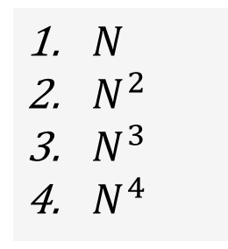
Pop quiz on arrays
Q. How many multiplications to multiply two N-by-N matrices?
double c[N][N] = {};
for (int i = 0; i < N; i++)
for (int j = 0; j < N; j++)
for (int k = 0; k < N; k++)
c[i][j] += a[i][k] * b[k][j];
$N$
$N^{2}$
$N^{3}$
$N^{4}$

Slide 8

Pop quiz 3 on arrays
Q. How many multiplications to multiply two N-by-N matrices?
double c[N][N] = {};
for (int i = 0; i < N; i++)
for (int j = 0; j < N; j++)
for (int k = 0; k < N; k++)
c[i][j] += a[i][k] * b[k][j];
$N$
$N^{2}$
$N^{3}$
$N^{4}$
Nested for loops: $N×N×N$

Slide 9
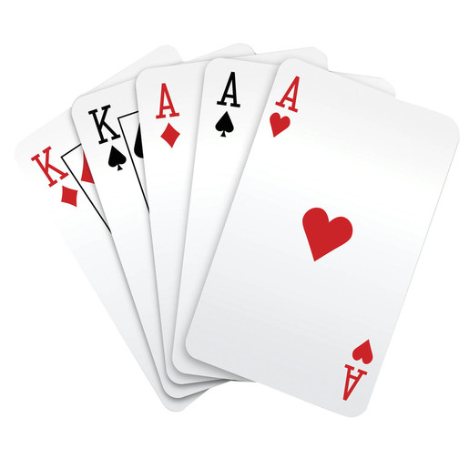
Example of array use: create a deck of cards
#include<iostream>
#include<string>
int main() {
std::string rank[] {"2", "3", "4", "5", "6", "7", "8", "9", "10", "J", "Q", "K", "A" };
std::string suit[] {"C", "D", "S", "H"}; // Club, Diamond, Spade, Heart
std::string deck[52];
for (int j = 0; j < 4; j++)
for (int i = 0; i < 13; i++)
deck[i + 13*j] = rank[i] + suit[j];
for(int i=0; i<52; i++)
std::cout << deck[i] << " ";
std::cout << std::endl;
}
a
2C 3C 4C 5C 6C 7C 8C 9C 10C JC QC KC AC
2D 3D 4D 5D 6D 7D 8D 9D 10D JD QD KD AD
2S 3S 4S 5S 6S 7S 8S 9S 10S JS QS KS AS
2H 3H 4H 5H 6H 7H 8H 9H 10H JH QH KH AH

Slide 10
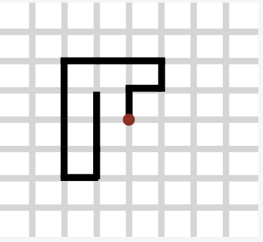
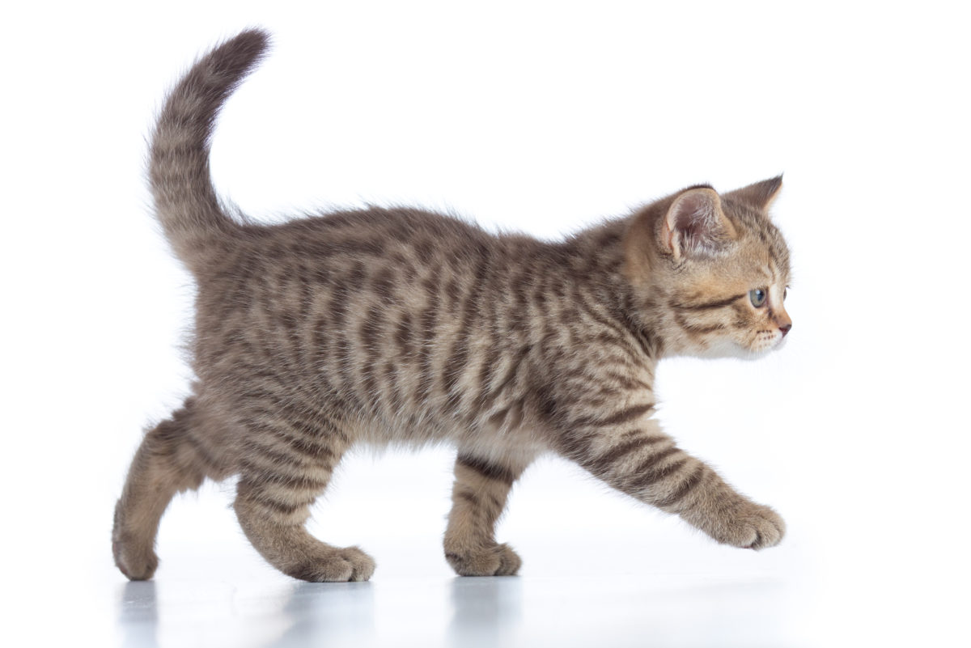
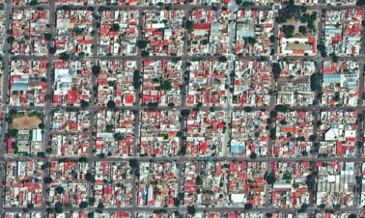
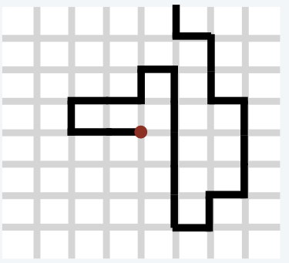
Self-avoiding random walks
A cat walks around at random in a city, never revisiting any intersection.
Q. Does the cat escape?
dead end
Model: a random process in an N-by-N lattice
Start in the middle.
Move to a random neighboring intersection but do not revisit any intersection.
Outcome 1 (escape): reach edge of lattice.
Outcome 2 (dead end): no unvisited neighbors.
Q. What are the chances of reaching a dead end?
escape

Slide 11
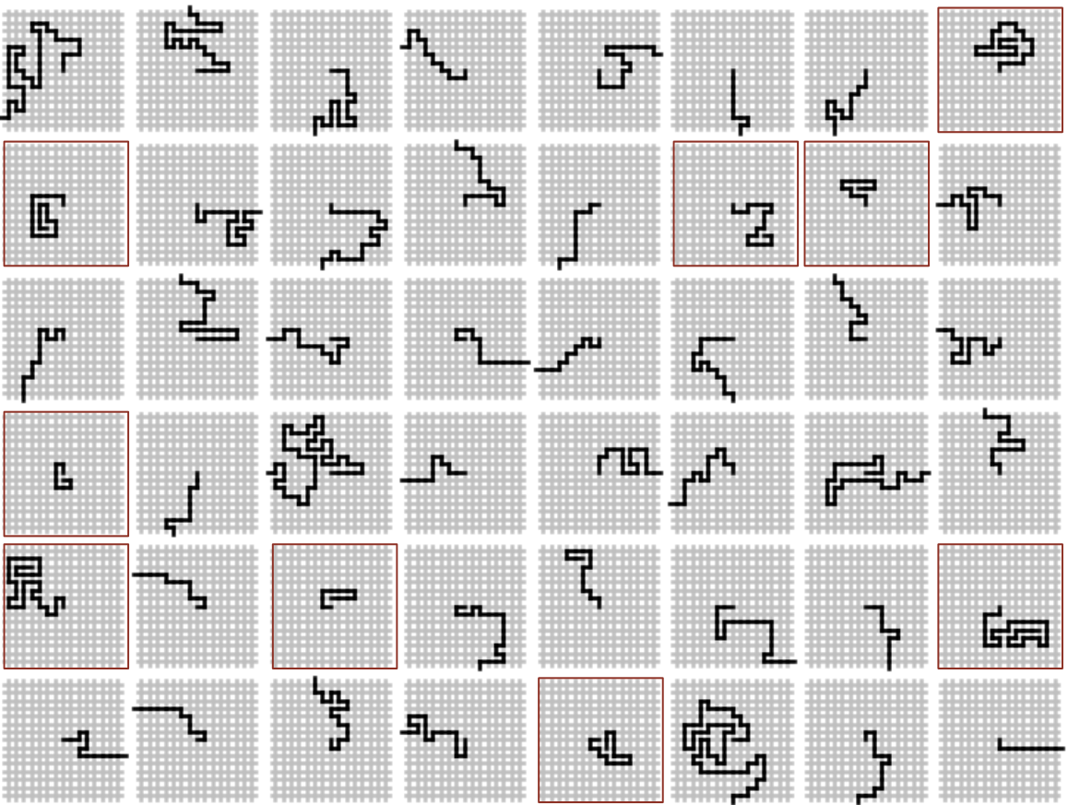
Self-avoiding random walks

Slide 12
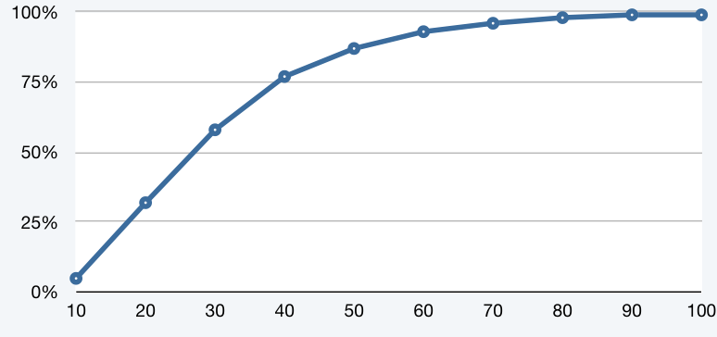
Application of 2D arrays: self-avoiding random walks
const int N = 20, trials = 1000;
int deadEnds = 0;
for (int t = 0; t < trials; t++) {
bool a[N][N] = {};
int x = N/2, y = N/2;
while (x > 0 && x < N-1 && y > 0 && y < N-1) {
if (a[x-1][y] && a[x+1][y] && a[x][y-1] && a[x][y+1])
{ deadEnds++; break; }
a[x][y] = true;
int r = rand() % 4;
if (r==0) { if (!a[x+1][y]) x++; }
else if (r==1) { if (!a[x-1][y]) x--; }
else if (r==2) { if (!a[x][y+1]) y++; }
else { if (!a[x][y-1]) y--; }
}
}
cout << (100*deadEnds/trials) << "% dead ends";

Slide 13
Your first data structure
Arrays: A basic building block in programming
• They enable storage of large amounts of data (values all of the same type).
• With an index, a program can instantly access a given value.
• Efficiency derives from low-level computer hardware organization (stay tuned).

